Slide 1
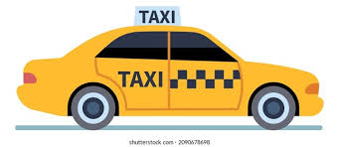

How to bec0me a taxiMAN

Slide 2
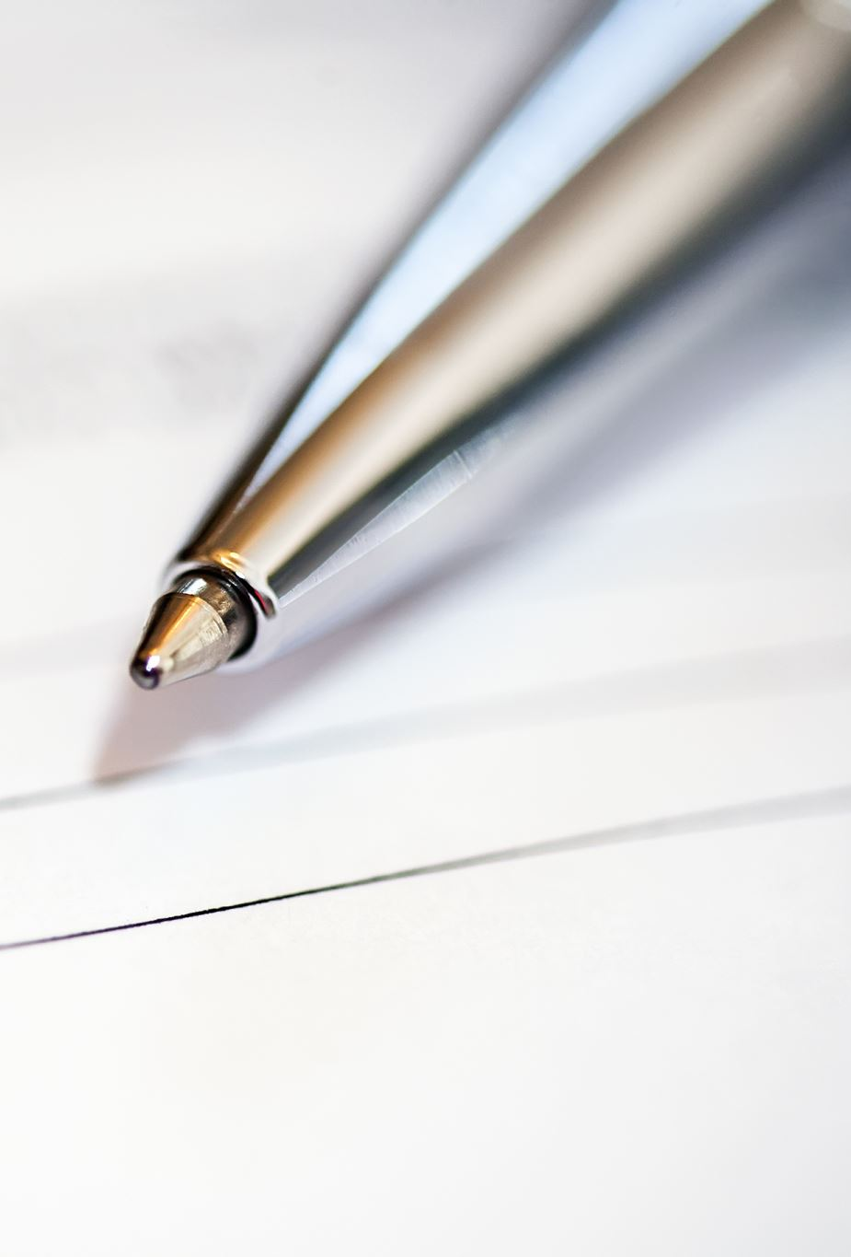
Apply for it
TRN
DOB
ADDRESS
GENDER
EMAIL
CONTACTNUM

Slide 3

Interview
Did the driver cause any accident(s) within the last two years?
Does the driver have a negative police record?
Does the driver have any outstanding tickets?

Slide 4

CONGRALUATIONS, You have your ppv license!!

Slide 5
PPVLICENSE
trn
badgeNum – e.g. PPV123456
badgeIssueDate
badgeExpiryDate

Slide 6
IDON’T CARE ABOUT THE LAW, I NEED MONEY!!!

Slide 7
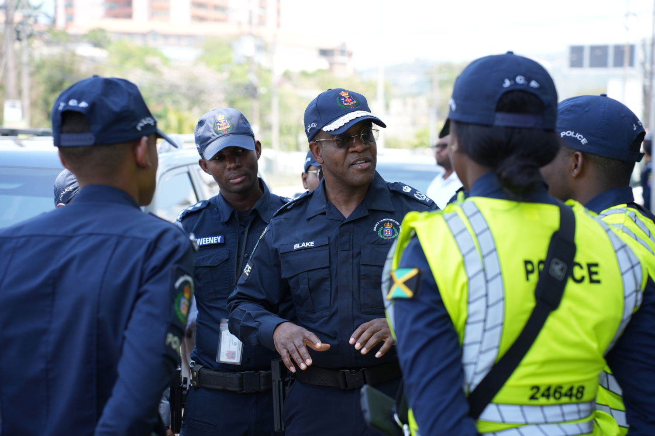

TICKETS
01/01/2025
02/02/2025

Slide 8
It IS STORED IN THE SYSTEM
- ticketNum: int
- ticketIssueDate: Date
- ticketDueDate: Date
- offenseCode: String
- offenseDesc: String
- fineAmt: float
-ticketStatDesc: String
-courtDate: Date
-courtTime: Time
-courtLocation: Address
-totalUnpaidTic: float
-totalFineAmt: float
-warrant: Boolean

Slide 9
Tickets have 21 days to be paid
What happens when this date has passed?

Slide 10
You get a court date
Which is 7 days (1 week) after the ticketDueDate

Slide 11
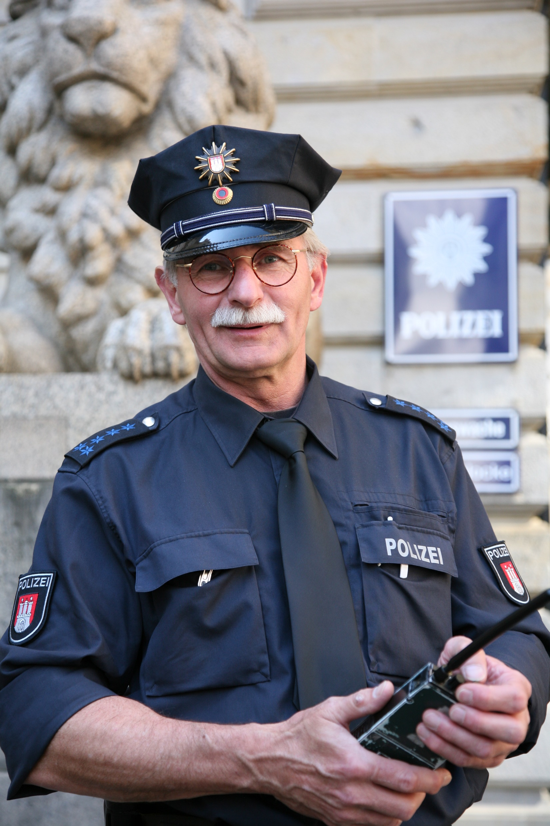
What happens when you miss the court date?
You will be given a warranty for arrest. One day after the court date has passed.
So warranty would become true.

Slide 12
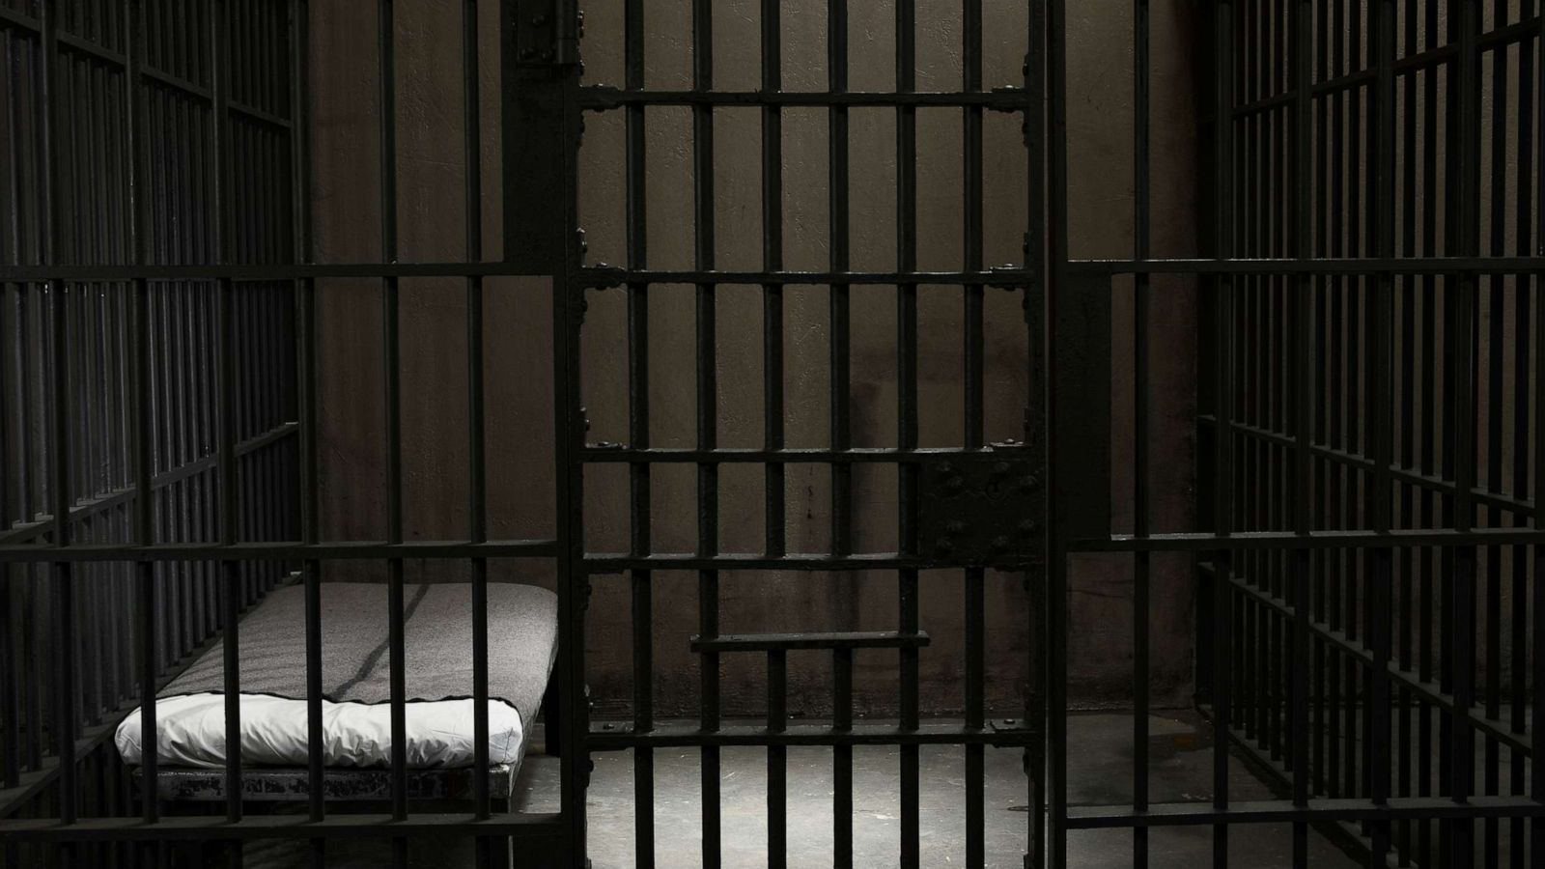
NOT BE LIKE BOB!

